Slide 1
Database Planning, Design and Management I

Slide 2
MODULE II
Database Models and Modeling

Slide 3
Module Summary
Conceptual model
Logical model
Physical model
Hierarchical model
Relational model
Entity-Attribute-Value (EAV) data model

Slide 4
Database Models
What is a database model?
A database model shows the logical structure of a database, including the relationships and constraints that determine how data can be stored and accessed.
A Database model defines the logical design and structure of a database and defines how data will be stored, accessed and updated in a database management system.
The data model emphasizes on what data is needed and how it should be organized instead of what operations will be performed on data.
Data Model is like an architect's building plan, which helps to build conceptual models and set a relationship between data items.
What is data modeling ?
Data modeling (data modeling) is the process of creating a data model for the data to be stored in a database.

Slide 5
Why use Data Model?
Ensures that all data objects required by the database are accurately represented. Omission of data will lead to creation of faulty reports and produce incorrect results.
A data model helps design the database at the conceptual, physical and logical levels.
Data Model structure helps to define the relational tables, primary and foreign keys and stored procedures.
It provides a clear picture of the base data and can be used by database developers to create a physical database.
It is also helpful to identify missing and redundant data.
Though the initial creation of data model is labor and time consuming, in the long run, it makes your IT infrastructure upgrade and maintenance cheaper and faster.

Slide 6
Types of data models
Conceptual Data Model:
This is an organized view of database concepts and their relationships. The purpose of creating a conceptual data model is to establish entities, their attributes, and relationships.
In this data modeling level, there is hardly any detail available on the actual database structure. Business stakeholders and data architects typically create a conceptual data model.
The 3 basic elements of Conceptual Data Model are
Entity: A real-world thing
Attribute: Characteristics or properties of an entity
Relationship: Dependency or association between two entities
Data model example:
Customer and Product are two entities. Customer number and name are attributes of the Customer entity
Product name and price are attributes of product entity
Sale is the relationship between the customer and product

Slide 7
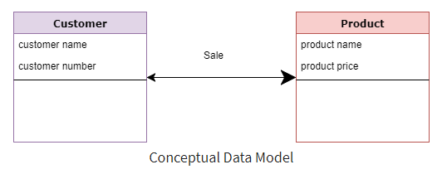
Conceptual Data Model Cont..

Slide 8
Characteristics of a conceptual data model
Focuses on essential elements and their relationships, abstracting away unnecessary details.
Does not concern itself with how data is stored physically or specific technical details.
Offers Organization-wide coverage of the business concepts.
This type of Data Models are designed and developed for a business audience.
The conceptual model is developed independently of hardware specifications like data storage capacity, location or software specifications like DBMS vendor and technology. The focus is to represent data as a user will see it in the "real world."
Conceptual data models known as Domain models create a common vocabulary for all stakeholders by establishing basic concepts and scope.

Slide 9
Importance of Conceptual Models
Assists in understanding and capturing the requirements of the system.
Serves as a communication tool between stakeholders, including developers, designers, and end-users.
Guides the transition from the conceptual model to the logical model. It provides a foundation for creating tables, relationships, and constraints in the logical design phase.
Acts as a documented reference for future developers, administrators, and analysts.

Slide 10
Challenges
Interpretation of entities, relationships, and attributes can be subjective and may vary among stakeholders.
Conceptual models may need to evolve as requirements change or become more refined.
Striking a balance between capturing essential complexity and maintaining simplicity is a constant challenge.
Defining the appropriate scope of the conceptual model is crucial to avoid over-complication or oversimplification.

Slide 11
Logical Data Model
The Logical Data Model is used to define the structure of data elements and to set relationships between them.
The logical data model adds further information to the conceptual data model elements.
It involves defining tables, relationships, keys, and constraints in a way that aligns with the chosen data model.
The advantage of using a Logical data model is to provide a foundation to form the base for the Physical model.
At this Data Modeling level, no primary or secondary key is defined. At this Data modeling level, you need to verify and adjust the connector details that were set earlier for relationships.

Slide 12
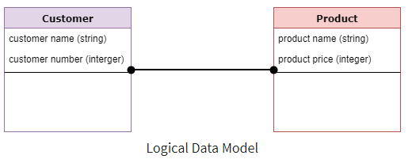
Logical Data Model Cont..

Slide 13
Characteristics of a Logical data model
Entities from the conceptual model are translated into tables in the logical model.
Attributes identified in the conceptual model become columns in the tables of the logical model.
Primary keys uniquely identify each record in a table. Foreign keys establish relationships between tables by linking to the primary key of another table.
It has data types that Specify the type of data that can be stored in each column (e.g., integers, strings, dates). It ensures data integrity and efficiency in storage.
It has constraints that enforce rules or conditions on the data to maintain consistency.
Designed and developed independently from the DBMS.
Normalization processes to the model is applied typically till 3NF.

Slide 14
Importance of Logical Models
Guides the physical implementation of the database by defining the structure that will be created in the DBMS.
Helps in designing queries and transactions by providing a clear understanding of how data is organized.
A well-designed logical model supports efficient data retrieval and manipulation.
Enforces data integrity through the use of keys, constraints, and relationships.
A logical model can be designed to support scalability by considering factors such as indexing and partitioning.

Slide 15
Physical Data Model
A Physical Data Model describes a database-specific implementation of the data model.
It offers database abstraction and helps generate the schema. This is because of the richness of meta-data offered by a Physical Data Model. The physical data model also helps in visualizing database structure by replicating database column keys, constraints, indexes, triggers, and other RDBMS features.

Slide 16
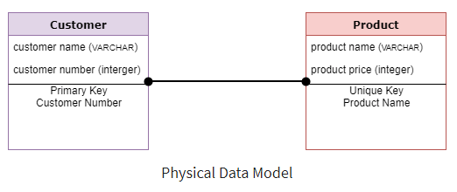
Physical Data Model Cont..

Slide 17
Characteristics of a physical data model:
The physical data model describes data need for a single project or application though it maybe integrated with other physical data models based on project scope.
Data Model contains relationships between tables that which addresses cardinality and nullability of the relationships.
Developed for a specific version of a DBMS, location, data storage or technology to be used in the project.
Columns should have exact data types, lengths assigned and default values.
Primary and Foreign keys, views, indexes, access profiles, and authorizations, etc. are defined.

Slide 18
Advantages of Data model:
The main goal of a designing data model is to make certain that data objects offered by the functional team are represented accurately.
The data model should be detailed enough to be used for building the physical database.
The information in the data model can be used for defining the relationship between tables, primary and foreign keys, and stored procedures.
Data Model helps business to communicate the within and across organizations.
Data model helps to documents data mappings in ETL process
Help to recognize correct sources of data to populate the model

Slide 19
Disadvantages of Data model:
To develop Data model one should know physical data stored characteristics.
This is a navigational system produces complex application development, management. Thus, it requires a knowledge of the biographical truth.
Even smaller change made in structure require modification in the entire application.
There is no set data manipulation language in DBMS.

Slide 20
Hierarchical model
This database model organizes data into a tree-like-structure, with a single root, to which all the other data is linked.
The hierarchy starts from the Root data, and expands like a tree, adding child nodes to the parent nodes.
In this model, a child node will only have a single parent node.
This model efficiently describes many real-world relationships like index of a book, recipes etc.
In hierarchical model, data is organized into tree-like structure with one one-to-many relationship between two different types of data, for example, one department can have many courses, many professors and of-course many students.

Slide 21
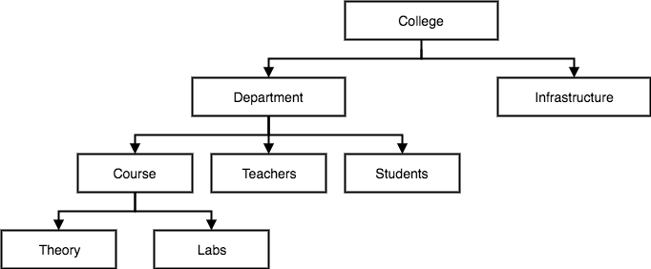
Hierarchical model

Slide 22
Characteristics of a hierarchical model
Organizes data in a tree-like structure, resembling an organizational chart.
Each record (except for the root) has exactly one parent, forming a strict hierarchy.
The top-level node in the hierarchy is called the root. The root has no parent, and all other nodes descend from it.
Data is stored in segments or records, each containing fields or attributes.
Accessing data in the hierarchical model requires navigation through the hierarchy.
The hierarchical model provides a rigid structure, making it suitable for specific use cases with well-defined relationships.

Slide 23
Advantages of a hierarchical model
Well-suited for representing one-to-many relationships where each parent has multiple children.
Works well for scenarios where data relationships are well-defined and relatively stable.

Slide 24
Disadvantages of a hierarchical model
Limited flexibility in handling changes to the structure or relationships. Modifying the hierarchy can be complex.
Complex queries and data retrieval, especially when dealing with relationships that are not well-suited to a hierarchical structure.
Inefficient for representing many-to-many relationships, which are common in real-world scenarios.
Can lead to data redundancy and duplication as the same data may be stored in multiple places.
Maintenance can be challenging, especially when dealing with dynamic or evolving data structures.

Slide 25
Relational model
In this model, data is organized in two-dimensional tables and the relationship is maintained by storing a common field.
It has been the most widely used database model, in fact, we can say the only database model used around the world.
The basic structure of data in the relational model is tables. All the information related to a particular type is stored in rows of that table.
Hence, tables are also known as relations in relational model.

Slide 26
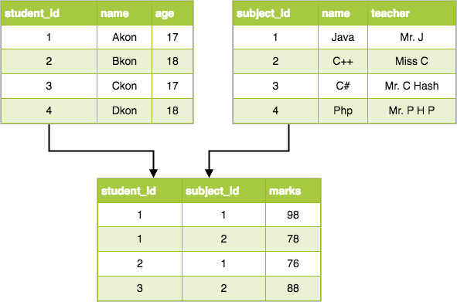
Relational model

Slide 27
Characteristics of a relational
Data is organized into tables, also known as relations. Each table represents a specific entity or relationship in the real world.
Each row in a table represents a unique record or instance of the entity being modeled.
Columns represent the attributes or properties of the entity.
Each table has a primary key, a unique identifier for each row.
A foreign key establishes relationships between tables by linking the primary key of one table to the foreign key of another.
The relational model supports both physical and logical data independence.
There is Normalization that eliminates data redundancy and dependency by organizing data into related tables.

Slide 28
Advantages of the Relational Model
Simplicity and Clarity: Provides a clear and intuitive representation of data with tables and relationships.
Flexibility: Adaptable to a wide range of applications and data structures.
Data Integrity: Enforces data integrity through primary and foreign key constraints.
Normalization: Normalization techniques help ensure that data is organized efficiently and anomalies are minimized.
Powerful Query Language (SQL): SQL allows users to express complex queries, updates, and transactions in a declarative manner.

Slide 29
Challenges of relational model
Performance: Complex queries and large datasets may impact performance.
Many-to-Many Relationships: Modeling many-to-many relationships may require the use of junction tables. Requires additional consideration and understanding.
Schema Changes: Changes to the schema can be more challenging, especially in large databases.
Understanding and mastering SQL and relational concepts may pose a learning curve for some users.

Slide 30
Entity-Attribute-Value (EAV) Data Model
A flexible and dynamic approach where data is stored in a three-column table consisting of entities, attributes, and values.
Allows for the storage of highly variable or sparse data.
Commonly used in situations where the schema is not known in advance or where extreme flexibility is required.
Can be challenging to query and maintain due to its inherent complexity.

Slide 31
Advantages of the EAV Data Model
Flexibility: Adaptability to changes in the data structure without altering the database schema.
Efficient Storage of Sparse Data: Efficiently stores sparse data by avoiding the need for dedicated columns for each attribute.
Dynamic Attribute Addition: Supports the dynamic addition of new attributes without requiring alterations to the table structure.
Applicability to Diverse Domains: Useful in domains where entities may have highly variable attributes, such as in content management systems or e-commerce platforms.

Slide 32
Challenges of the EAV Data Model
Complex Querying: Querying data in an EAV model can be complex and less intuitive than in traditional relational models.
The dynamic and extensible nature of the EAV model can lead to performance challenges, especially in scenarios with large datasets and complex queries.
Ensuring data integrity and validation may be challenging in the absence of a predefined schema.

